Slide 1
CASE STUDY
SPACE SHUTTLE CHALLANGER

Slide 2
CASE
Date &Year : 28th Jan1986
Technical problem : O-rings

Slide 3
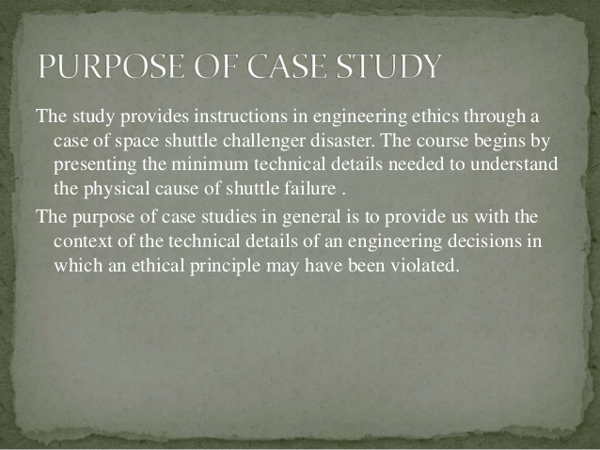

Slide 4
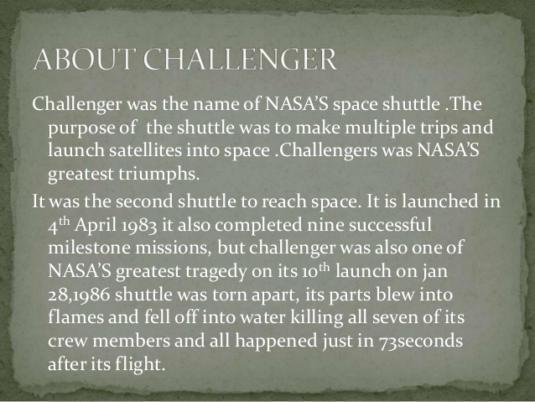

Slide 5
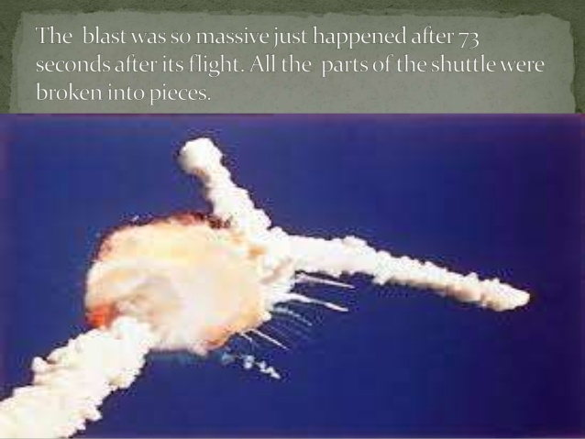

Slide 6
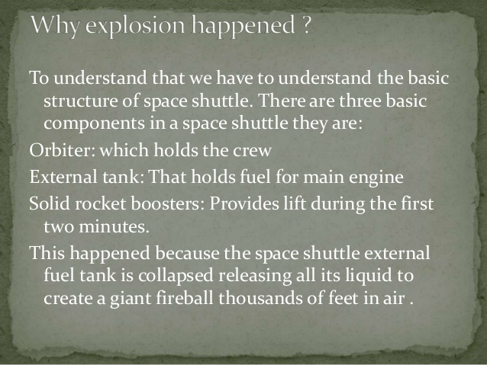

Slide 7
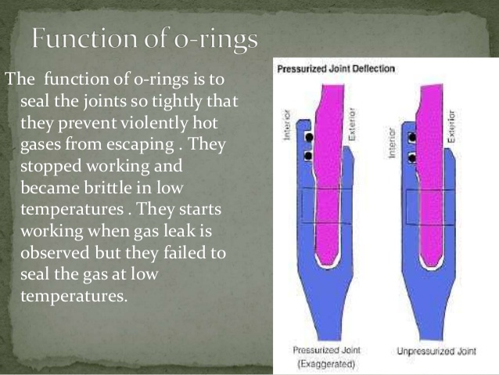

Slide 8
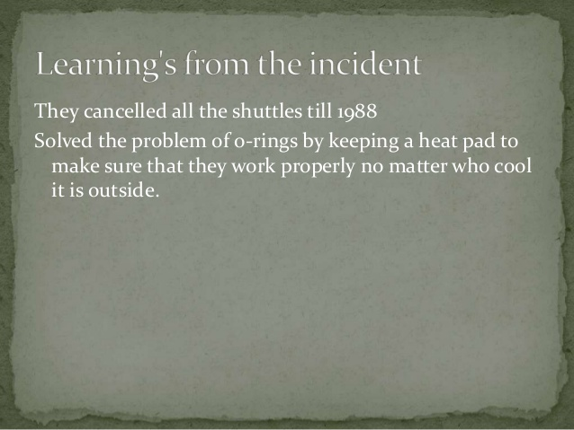

Slide 9


